Slide 1
2023 Construction Economic Update and Exclusive Forecast
The webinar will start momentarily.
By: Anirban Basu, MPP, MA, JD, PhD Sage Policy Group Inc.
Sponsored By

Slide 2
Thank You to Our Sponsors for Making This Webinar Possible

Slide 3
2023 Construction Economic Update and Exclusive Forecast
By: Anirban Basu
MPP, MA, JD, PhD
Sage Policy Group Inc.
On Behalf of
Construction Executive
Dec. 14, 2022

Slide 4
2022: A Look Back

Slide 5
Global Inflation Forecasts: Serial Upside Surprises
Source: International Monetary Fund, World Economic Outlook, October 2022
Notes:
Copyright terms: commercial use of data from database OK with citation; other conditions
All copyright terms: https://www.imf.org/external/terms.htm
Copyright terms regarding commercial use of data: https://www.imf.org/external/terms.htm#:~:text=SPECIAL%20TERMS%20AND%20CONDITIONS%20PERTA INING%20TO%20THE%20USE%20OF%20DATA

Slide 6
U.S. Consumer Price Index (NSA) 12-Month % Change, 2000 – November 2022
Source: U.S. Bureau of Labor Statistics
Notes:
NSA graph: https://fred.stlouisfed.org/graph/?g=QCit
SA graph: https://fred.stlouisfed.org/graph/?g=JTzb
All Items-SA/NSA, Index value: https://fred.stlouisfed.org/graph/?g=R7Rf
All Items Less Food & Energy-SA/NSA, Index value: https://fred.stlouisfed.org/graph/?g=R7Rn
Linking and Copyright Information: https://www.bls.gov/bls/linksite.htm

Slide 7
Inputs to Construction PPI 12-Month % Change, 2001 – November 2022
Source: U.S. Bureau of Labor Statistics. Note: Data are not seasonally adjusted
Notes:
WPUIP2300001
Linking and Copyright Information: https://www.bls.gov/bls/linksite.htm

Slide 8
A Statement is Not Enough
“…Inflation has risen, largely reflecting transitory factors...”
(FOMC Statement, June 2021)
“…Inflation has risen, largely reflecting transitory factors...”
(FOMC Statement, July 2021)
“…Inflation is elevated, largely reflecting transitory factors...”
(FOMC Statement, September 2021)
“…Inflation is elevated, largely reflecting factors that are expected to be transitory…”
(FOMC Statement, November 2021)
“Supply and demand imbalances related to the pandemic and the reopening of the economy have continued to contribute to elevated levels of inflation.”
(FOMC Statement, December 2021)
“…These problems have been larger and longer lasting than anticipated, exacerbated by waves of the virus. As a result, overall inflation is running well above our 2 percent longer-run goal and will likely continue to do so well into next year.” (FOMC Chair Jerome Powell, December 2021)
Source: Federal Reserve
Notes:
https://www.federalreserve.gov/monetarypolicy/fomccalendars.htm
Specific Statement Dates
April: FOMC statement/Press release, April 28, 2021
June: Federal Reserve FOMC Statement/Press Release, June 16, 2021
July: Federal Reserve FOMC Statement/Press Release, July 28, 2021
September: Federal Reserve FOMC Statement/Press Release, September 22, 2021
November: Federal Reserve FOMC Statement/Press Release, November 3, 2021

Slide 9
Federal Funds Target Range, Upper Limit
Source: Board of Governors of the Federal Reserve System
Notes:
https://fred.stlouisfed.org/series/DFEDTARU

Slide 10
POLL: Which of these is the leading challenge for your company today?
Supply chain and/or materials issues
Skills/worker shortages
Insufficient demand for construction services
Availability of financing for projects/project work
None of the above

Slide 11
CE Webinar Audience Poll Results: “Which of these is the leading challenge for your company today?”

Slide 12
Economic Update

Slide 13
U.S. Gross Domestic Product, 1990–2022Q3
Source: U.S. Bureau of Economic Analysis *2022Q3: 2nd estimate
Notes:
Adjust horizontal axis range using “select data”

Slide 14
U.S. Labor Force Participation Rate, 1950 – November 2022
Source: U.S. Bureau of Labor Statistics *Civilian Labor Force Participation Rate, Ages 16+
Notes:
https://fred.stlouisfed.org/series/CIVPART
LNS11300000
Linking and Copyright Information: https://www.bls.gov/bls/linksite.htm

Slide 15
U.S. Job Openings, 2015 – October 2022
Source: U.S. Bureau of Labor Statistics
Notes:
https://fred.stlouisfed.org/series/JTSJOL
Job openings (000s): JTS000000000000000JOL
Quits (000s): JTS000000000000000QUL
Linking and Copyright Information: https://www.bls.gov/bls/linksite.htm

Slide 16
Net Change in U.S. Jobs May 2020 – November 2022
Source: U.S. Bureau of Labor Statistics
Notes:
US Total Nonfarm (SA): CES0000000001
U.S. Unemployment Rate LNS14000000

Slide 17
U.S. Nonfarm Employment by Industry Sector February 2020 v. November 2022
Source: U.S. Bureau of Labor Statistics

Slide 18
Unemployment Rates, 25 Largest Metros October 2022
Rank | MSA | % |  | Rank | MSA | %
1 | Minneapolis-St. Paul-Bloomington, MN-WI | 1.7 |  | 13 | Dallas-Fort Worth-Arlington, TX | 3.4
2 | Miami-Fort Lauderdale-West Palm Beach, FL | 2.3 |  | 13 | Philadelphia-Camden-Wilm., PA-NJ-DE-MD | 3.4
3 | San Francisco-Oakland-Hayward, CA | 2.6 |  | 15 | Denver-Aurora-Lakewood, CO | 3.5
3 | Tampa-St. Petersburg-Clearwater, FL | 2.6 |  | 15 | Phoenix-Mesa-Scottsdale, AZ | 3.5
5 | St. Louis, MO-IL | 2.7 |  | 15 | San Antonio-New Braunfels, TX | 3.5
6 | Boston-Cambridge-Nashua, MA-NH | 2.8 |  | 18 | Charlotte-Concord-Gastonia, NC-SC | 3.7
6 | Orlando-Kissimmee-Sanford, FL | 2.8 |  | 18 | New York-Newark-Jersey City, NY-NJ-PA | 3.7
8 | Atlanta-Sandy Springs-Roswell, GA | 2.9 |  | 18 | Portland-Vancouver-Hillsboro, OR-WA | 3.7
9 | San Diego-Carlsbad, CA | 3.2 |  | 21 | Riverside-San Bernardino-Ontario, CA | 3.9
10 | Detroit-Warren-Dearborn, MI | 3.3 |  | 22 | Baltimore-Columbia-Towson, MD | 4.0
10 | Seattle-Tacoma-Bellevue, WA | 3.3 |  | 22 | Los Angeles-Long Beach-Anaheim, CA | 4.0
10 | Washington-Arlington-Alexandria, DC-VA-MD-WV | 3.3 |  | 24 | Houston-The Woodlands-Sugar Land, TX | 4.1
 |  |  |  | 25 | Chicago-Naperville-Elgin, IL-IN-WI | 4.3
Source: U.S. Bureau of Labor Statistics,
Local Area Unemployment Statistics (LAUS) program.
Note: data are not seasonally adjusted.
U.S. Unemployment Rate: 3.7%
Notes:
Linking and Copyright Information: https://www.bls.gov/bls/linksite.htm

Slide 19
The Pain of Price Stability
“While higher interest rates, slower growth, and softer labor market conditions will bring down inflation, they will also bring some pain to households and businesses. These are the unfortunate costs of reducing inflation. But a failure to restore price stability would mean far greater pain.”
(FOMC Chair Jerome Powell, August 2022)
Source: Federal Reserve
Notes:
https://www.federalreserve.gov/monetarypolicy/fomc.htm
https://www.federalreserve.gov/monetarypolicy/fomccalendars.htm
Specific quote links
June 2021: https://www.federalreserve.gov/newsevents/pressreleases/monetary20210616a.htm
January 2022: https://www.federalreserve.gov/monetarypolicy/fomcpresconf20220126.htm
August 2022: https://www.federalreserve.gov/newsevents/speech/powell20220826a.htm
November 2022: https://www.federalreserve.gov/monetarypolicy/fomcpresconf20221102.htm

Slide 20
15-Year & 30-Year Fixed Mortgage Rates 1995 – December 2022*
*Week ending 12/8/2022
Source: Freddie Mac
Notes:
Weekly:
https://fred.stlouisfed.org/graph/?g=pHTO
http://www.freddiemac.com/pmms/archive.html
Monthly:
https://fred.stlouisfed.org/graph/?g=pPxM
http://www.freddiemac.com/pmms/pmms15.htm
http://www.freddiemac.com/pmms/pmms30.htm

Slide 21
U.S. Residential Building Permits 1995 – October 2022
Source: U.S. Census Bureau
Notes:
http://www.census.gov/construction/nrc/
8:30A
Historical data, Housing Units Authorized in Permit‐Issuing Places
Citing Our Internet Information: https://www.census.gov/about/policies/citation.html

Slide 22
Architecture Billings Index 2008 – November 2022
Source: The American Institute of Architects
Notes:
Most recent release:
http://new.aia.org/press-releases/6576939-demand-for-design-services-continues-to-sl
http://new.aia.org/press-releases?query=
http://new.aia.org/resources/10046-the-architecture-billings-index
http://www.architectmagazine.com/

Slide 23
ABC Construction Backlog Indicator 2012 – November 2022
Source: Associated Builders and Contractors; Sage

Slide 24
Nonresidential Construction Spending by Subsector February 2020 v. October 2022
Source: U.S. Census Bureau
Notes:
https://www.census.gov/construction/c30/c30index.html
Citing Our Internet Information: https://www.census.gov/about/policies/citation.html

Slide 25
Construction Materials PPI 12-Month % Change as of November 2022
Inputs to
Construction Industries:
+11.9% YOY
Source: U.S. Bureau of Labor Statistics. Note: Data are not seasonally adjusted
Notes:
WPUIP2300001
Linking and Copyright Information: https://www.bls.gov/bls/linksite.htm

Slide 26
Total Nonresidential Construction Spending Current/Constant Dollars, 2006 – 2022
Source: U.S. Census Bureau; U.S. Bureau of Labor Statistics
*Adjusted with U.S. Bureau of Labor Statistics Consumer Price Index, All Urban Consumers, U.S. City Average
Notes:
Index 2015=100: https://fred.stlouisfed.org/graph/?g=VwGT
Current dollars: https://fred.stlouisfed.org/graph/?g=VwGW

Slide 27
POLL: Over the last three months, how has your company’s backlog fared?
It has risen considerably
It has risen slightly
It has remained about the same
It has declined slightly
It has declined considerably

Slide 28
CE Webinar Audience Poll Results: "Over the last three months, how has your company’s backlog fared?"

Slide 29
2023: A Look Ahead

Slide 30
ABC Construction Confidence Index 2012 – November 2022
Source: Associated Builders and Contractors; Sage

Slide 31
ABC Construction Confidence Index February 2020 v. November 2022
Source: Associated Builders and Contractors; Sage

Slide 32
U.S. Manufacturers’ New Orders: Consumer Goods 1992 – October 2022
Source: U.S. Census Bureau. Note: Due to the nature of nondurable goods, the reporting figure for both their Shipments and New Orders will be identical.
Notes:
NOTE: Due to the nature of nondurable goods, the reporting figure for both their Shipments and New Orders will be identical.
Citing Our Internet Information: https://www.census.gov/about/policies/citation.html
Census M3: https://www.census.gov/manufacturing/m3/index.html
Graph of 1. shipments consumer nondurables** 2. new orders consumer durables: https://fred.stlouisfed.org/graph/?g=JBIt
Manufacturers' New Orders: Consumer Durable Goods: https://fred.stlouisfed.org/series/ACDGNO
Manufacturers' Value of Shipments: Consumer Nondurable** Goods: https://fred.stlouisfed.org/series/ACNGVS
**Due to the nature of nondurable goods, the reporting figure for both their Shipments and New Orders will be identical.

Slide 33
Philly Fed Manufacturing Business Outlook Survey Future Delivery Times, 2008 – November 2022
Future Delivery Times forecasts the change in delivery time over the next six months for reporting manufacturing firms.
Source: Federal Reserve Bank of Philadelphia *The diffusion index is calculated by taking the percent reporting increases and subtracting the percentage reporting decreases.
U.S. recessions
Notes:
*See notes on seasonal adjustment process for 2022 below
This graph: https://fred.stlouisfed.org/graph/?g=L2ep
Philly Fed Manufacturing Business Outlook Survey: https://www.philadelphiafed.org/surveys-and-data/regional-economic-analysis/manufacturing-business-outlook-survey
Future delivery time: https://fred.stlouisfed.org/series/DTFDFSA066MSFRBPHI
All FRED data series from Philly Fed Manufacturing Business Outlook Survey: https://fred.stlouisfed.org/release?rid=351
“Future Delivery Time forecasts the change in delivery time over the next six months for reporting manufacturing firms. The diffusion index is calculated by taking the percent reporting increases and subtracting the percentage reporting decreases.
Current Delivery Time reports the change in delivery time compared to the previous month for reporting manufacturing firms. The diffusion index is calculated by taking the percent reporting increases and subtracting the percentage reporting decreases.”
Recessions:
https://fredhelp.stlouisfed.org/fred/data/understanding-the-data/recession-bars/
https://fred.stlouisfed.org/series/USRECQM
https://fred.stlouisfed.org/series/USRECM
**Manufacturing Business Outlook Survey – Seasonal Adjustment Process for 2022, 06 Jan ’22
In January of each year, the Federal Reserve Bank of Philadelphia calculates new seasonal adjustment factors for the upcoming year for the Manufacturing Business Outlook Survey using data through December of the previous calendar year and publishes historical data revisions that incorporate these new seasonal factors.
However, due to atypical volatility at the onset of the pandemic as well as ongoing uncertainty about the pandemic’s impacts on seasonal factors, we have not incorporated data from 2020 or 2021 and are re-using factors for 2020 for both 2021 and 2022. Therefore, we have not revised the historical data.
Seasonal factors for 2022 are based on the U.S. Census Bureau's Census X-12 program for 50 years of data through December 2019, and seasonal factors for the 12 months of 2022 as well as the 12 months of 2021 repeat the factors for the 12 months of 2020, which were projected in January 2020 using the X-12-ARIMA method. https://www.philadelphiafed.org/surveys-and-data/regional-economic-analysis/mbos-seasonal-adjustment-process-for-2022

Slide 34
Projected Growth in Output by Select Global Areas, 2023
2023 Global Output Growth Forecast: +2.7%
Source: International Monetary Fund, World Economic Outlook, October 2022

Slide 35
Major Economic Forecasts for U.S. GDP Growth
Source: IMF; OECD; World Bank
Notes:
https://www.imf.org/en/Publications/WEO
https://www.worldbank.org/en/publication/global-economic-prospects
https://www.oecd.org/economic-outlook/november-2022#gdp
http://www.oecd.org/economic-outlook/#gdp-projections
https://fas.org/sgp/crs/row/R46270.pdf

Slide 36
POLL: Where do you expect your company’s profit margins to be a year from now?
Substantially higher
Slightly higher
About the same
Slightly lower
Substantially lower

Slide 37
CE Webinar Audience Poll Results: "Where do you expect your company’s profit margins to be a year from now?"

Slide 38
Looking Ahead
This will be a year of growth, but 2023 will be very different.
The economy will remain unbalanced, with supply struggling to keep up with demand – Ukraine/Russia and Omicron/China/Europe hampering recovery.
Along with rising wages amidst the Great Resignation, that translates into higher-than-average economywide inflation in 2022 & 2023 (stagflation, anyone?).
Yes, I’m an economist, so I am forecasting interest rates to increase.

Slide 39
Q&A
Follow Construction Executive on Twitter @ConstructionMag
Subscribe to Construction Executive magazine (print, digital or both), CE Webinars and CE This Week all at once. ConstructionExec.com/subscribe
Subscribe to CE’s free weekly newsletter, CE This Week, for economic forecasts, workforce strategies, business tips and legal strategies, legal and regulatory advice and more—every week. CEThisWeek.com
And a huge thank you to our sponsors for making this webinar possible

Slide 40
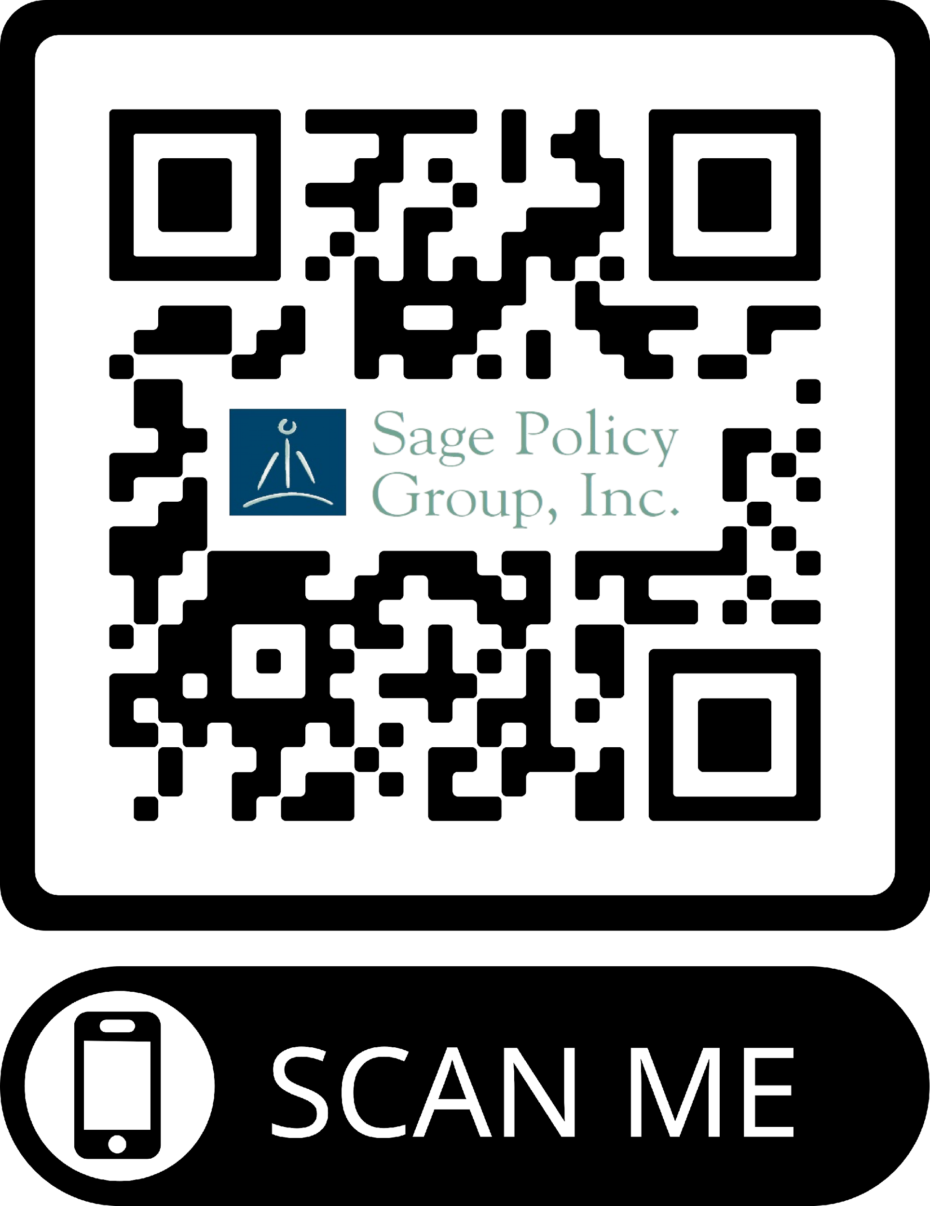
Thank You
Please contact us when you require economic research & policy analysis: www.sagepolicy.com
Sign up for our newsletter at Basu.substack.com
Free subscribers get:
An overview of the jobs report on the first Friday of every month
Occasional posts on specific economic & policy related subjects
Paid subscribers get:
A “Week in Review” post every Friday covering all the economic data releases, the best things I read, and, of course, my absence of humor
A monthly Q&A session

